Slide 1
Python Day 2
Skillup Academy

Slide 2
Agenda
Variables and assignment
Basic data types: int, float, string, boolean
Type casting and type checking
Basic input/output (print and input functions)

Slide 3
Variables
Python variables are simply containers for storing data values. Unlike other languages, such as Java, Python has no command for declaring a variable, so you create one the moment you first assign a value to it. Python variables are simply containers for storing data values.

Slide 4
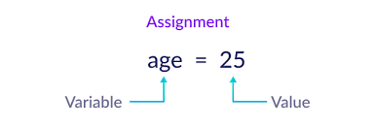

Slide 5
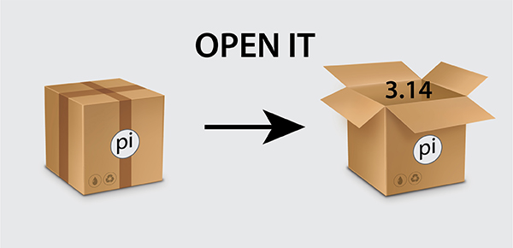

Slide 6
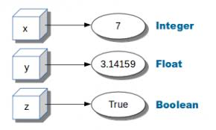

Slide 7
Data Types
Python has several built-in data types, including numeric types (int, float, complex), string (str), boolean (bool), and collection types (list, tuple, dict, set).

